Slide 1

Human-Computer Interaction
Unit 2
The Human
Human Input-Output Channels
Notes:
1

Slide 2
Input-Output Channels
Interaction with world
  Occurs through information
Interaction with computer
  Input and output
Human Input
  Through Senses
Human Output
  Through Effectors
Notes:
2

Slide 3
Input via Senses
Vision
Hearing
Touch
Taste
Smell
Notes:
1

Slide 4
Output via Effectors (Responders)
Limbs
Fingers
Eyes
Head
Vocal system
Notes:
1

Slide 5
Interaction with PC Using Input-Output Channels
Using a GUI-based computer
Information received by sight
Beeps received by ear
Feel keyboard and mouse with fingers
Notes:
1

Slide 6
Vision
Highly complex activity
Physical and perceptual limitations
2 stages of visual perception:
  Physical reception of the stimulus
  Interpretation/processing of stimulus
Processing allows construction of images from incomplete information

Slide 7
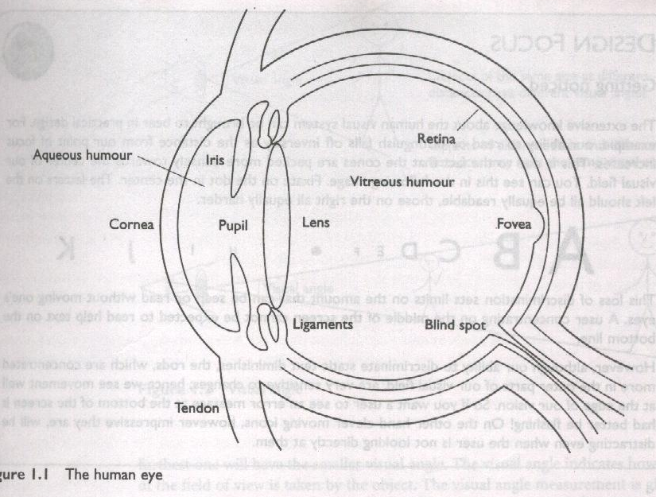
Human Eye

Slide 8
Image Formation
Cornea and lens
  Focuses light into a sharp image on retina
  An upside down image is formed on the retina.

Slide 9
Photoreceptors
Rods
Cones

Slide 10
Rods
Situated towards the edges of retina
  Dominate peripheral vision
Sensitive to light
  Allow us to see under low level of illumination
Unable to resolve fine detail and are subject to light saturation
  Cause of temporary blindness when moving from dark areas to very bright ones
120 million rods per eye

Slide 11
Cones
Less sensitive to light
  Can tolerate more light than Rods
Basic function is color vision
Situated in Fovea
  Small area on retina where image is fixated
Three types
  Each sensitive to a different wavelength

Slide 12
Blind Spot
Area where optic nerve enters
No rods or cones in this area
Visual system compensates for lack of rods and cones

Slide 13
Nerve Cells
Also called as. Ganglion Cells
Specialized Nerve Cells
Types
  X-cells
    concentrated in fovea
    detection of patterns
  Y-cells
    widely distributed in retina
    early detection of movement
    can not detect change in patterns

Slide 14
Visual Perception
Size
Depth
Brightness
Color

Slide 15
Notions of Size and Distance
You are standing on a hill
Rocks, sheep and small tree on summit
Farmhouse on hillside
Person walking on track
Small market town in valley

Slide 16

Perceiving Size and Depth
Size specified by visual angle
Affected by both
  Size of object
  Distance from eye

Slide 17
Perceiving Size and Depth
Visual angle
  Indicates how much of the field of view is taken by the object
  Measured in degree or minutes of arc

Slide 18
Visual Angle and Perception
Visual Acuity
  Visual Acuity is the ability of a person to perceive fine detail
  Objects with visual angles smaller than 0.5 seconds of an arc are not visible.
  Spaces between lines visible at 30s-1min of arc visible
Law of size constancy
  Perception of the object size remains constant even if it visual angle changes
  Perception depends on factors other than visual angle

Slide 19
Factors Affecting Visual Perception
Perception of depth
  Cues to determine relative positions of objects
    Objects overlapping
Size and height of object
  Provides cue for distance
Familiarity
  Certain size helps to judge the distance accordingly

Slide 20
Example
A B C D E F . H I J K

Slide 21
Perceiving Brightness
Brightness
  subjective reaction to levels of light
  affected by luminance of object
Luminance
  Depends on
    Amount of light falling on object
    Reflective properties of object
  Measured by photometer
Contrast
  Function of the luminance of an object and the luminance of its background

Slide 22
Perceiving Brightness
Measured by just noticeable difference caused by luminance
Rods (periphery) predominate in dim lighting
    Enables better periphery vision
Cones (center) not dominate in dim lighting
  Cannot fixate on images
Visual acuity increases with luminance
  Case for using high luminance displays
  Flicker also increases with luminance (>50Hz)
  Larger the display, the more it will appear to flicker

Slide 23
Perceiving Color
3 components
  Hue
    Determined by the spectral wavelength
      Blue (short)
      Green (medium)
      Red (long)
    150 hues determined by eye
  Intensity
    Brightness of color
  Saturation
    Amount of whiteness in the color
7 million colors can be perceived

Slide 24
Perceiving Color
Color perception best in fovea, worst at periphery
3-4% cones in fovea sensitive to blue light
  Blue acuity lower
Color blindness
  Cannot differentiate between green and red
  8% males
  1% females

Slide 25
Human Visual Perception
The visual system compensates for:
  movement
  changes in luminance.
Context is used to resolve ambiguity

Slide 26
Capabilities and Limitations of Visual Processing
Visual processing allows transformation and interpretation of a complete image
Visual processing compensates image movement
  Image moves on retina, but we see it stable
Color and brightness perceived constant (hue, intensity, saturation)

Slide 27
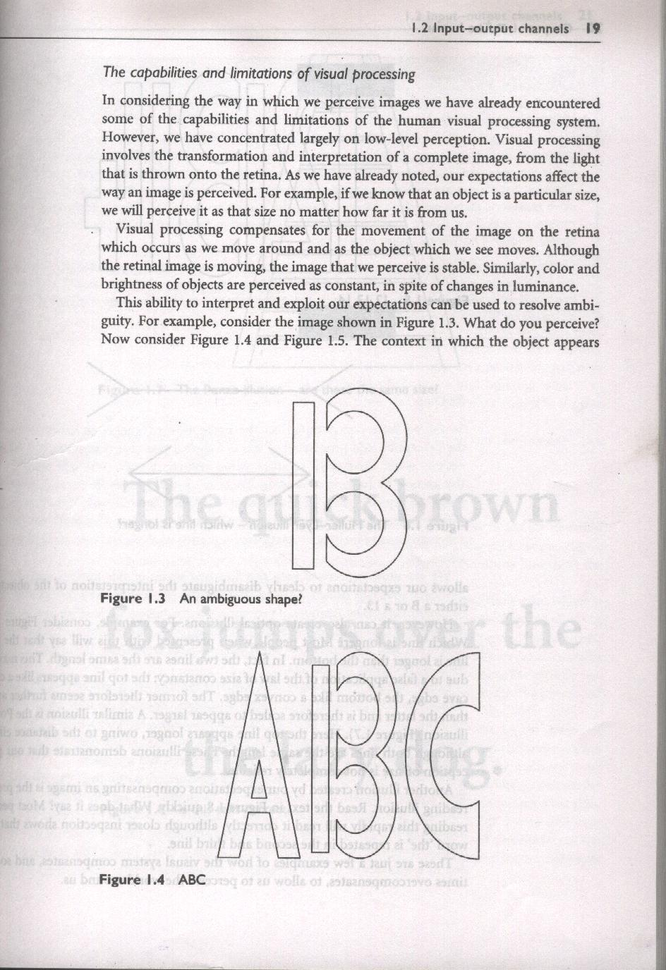
Context Illusions

Slide 28
Context Illusions

Slide 29
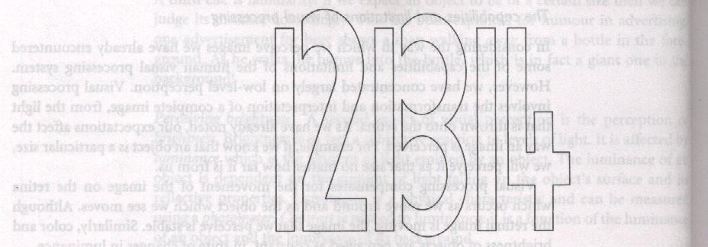
Context Illusions

Slide 30
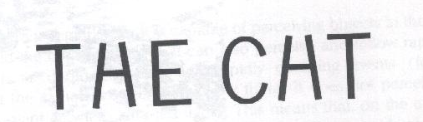
Context Illusions

Slide 31
Over Compensation Illusions
Optical illusions sometimes occur due to over compensation
  Our perception of size is not reliable
concave
convex
the Muller Lyer illusion
the Ponzo illusion

Slide 32
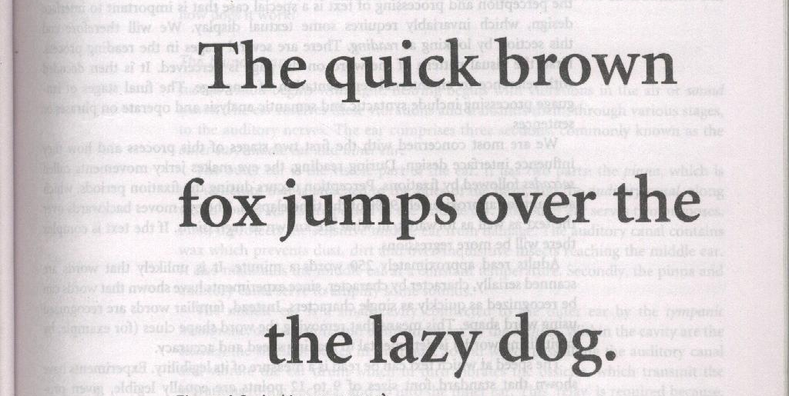
Proof-Reading Illusion

Slide 33
Proof-Reading Illusion

Slide 34
Lines & Optical Center Illusion
We do not perceive geometric objects exactly as they are drawn
Lines
  Horizontal: Magnified
  Vertical: Reduced
  Solution: To display square, increase height
Perceive actual center of page as a little lower
  Solution: place objects higher

Slide 35
Reading
Stages
  visual pattern perceived
  decoded using internal representation of language
  interpreted using knowledge of syntax, semantics, pragmatics
Reading involves saccades and fixations (perception here: 94%)
Perception occurs during fixations
Regressions: eye move backwards and forwards
Word shape is important to recognition
Negative contrast improves reading from computer screen
Average Reading Speed: 250 words per minute
  Word shape important
Reading speed is a measure of legibility
Legibility can be increased using negative contrast

